Slide 1







Bienvenidos!

Slide 2



Intro
3rd year of Spanish
We have links with partner schools
2 yr Erasmus+ programme 2017 - 2019

Slide 3

Objective of Coffee Morning:
How we learn Spanish at Orchard
What you can do to support your child and learn along side him / her

Slide 4
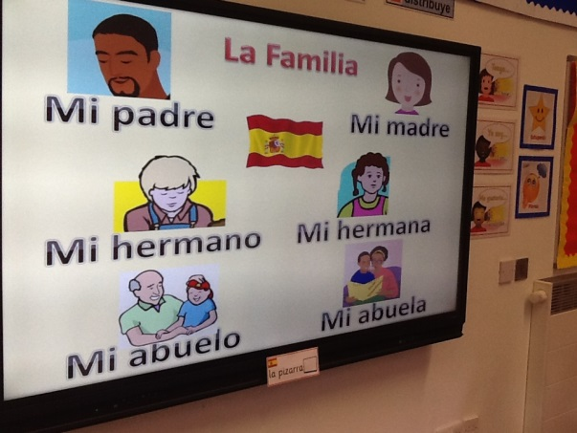
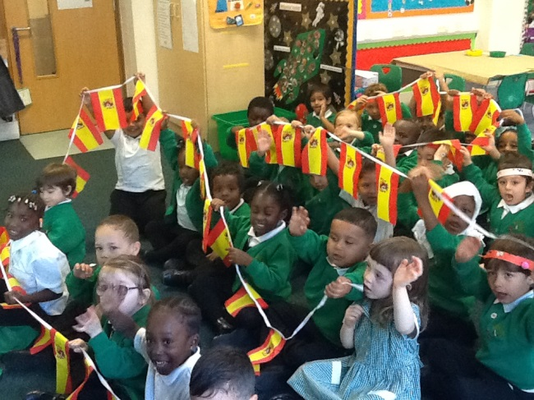
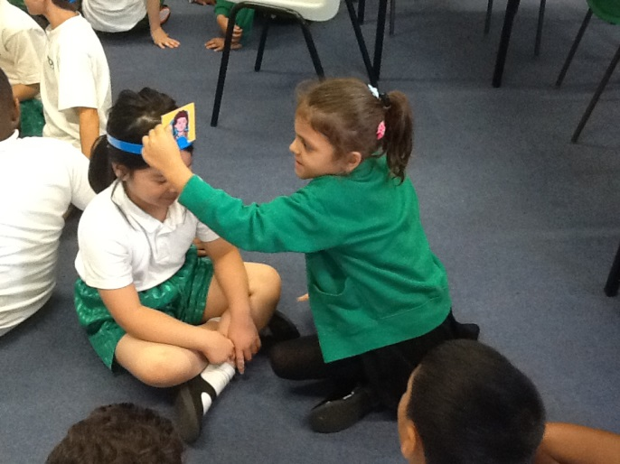
Spanish KS1
We have reviewed Spanish greetings and instructions and are now learning about the family.
Learning through:
Repetition
Actions / mime
Physical responses
Songs
Pair / group activities

Slide 5
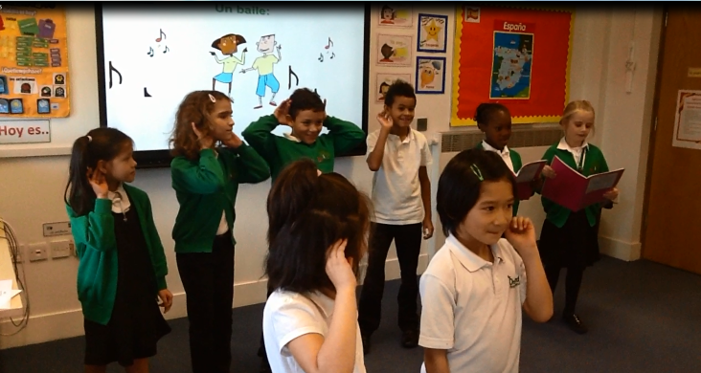
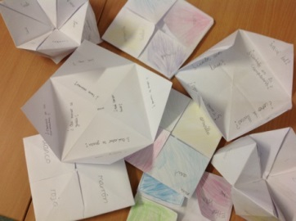
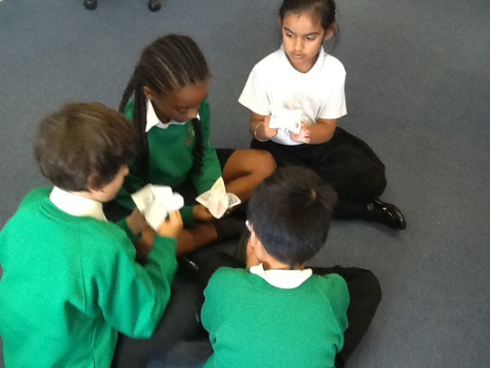
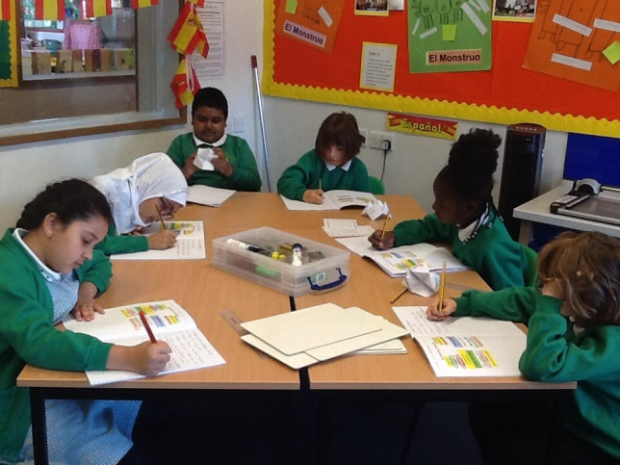
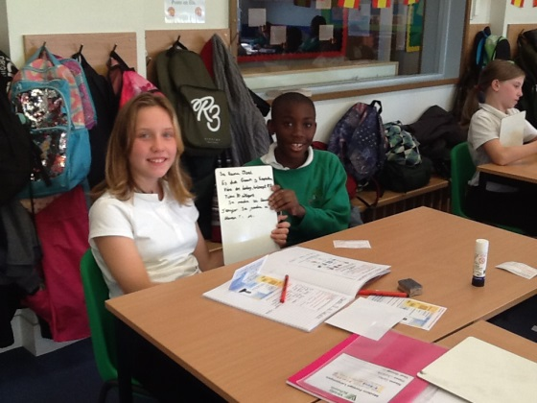
Yr 3: Instructions
Yr 4: Q&A of Personal Information
Yr 5&6: Completing Spanish identity cards
Spanish KS2
We have been reviewing Spanish classroom instructions, greetings and how to say our names in Spanish through games and songs.
Learning through:
Repetition
Actions / mime
Physical responses
Songs
Pair / group speaking activities
Reading & writing activities
Focus on grammar and structures

Slide 6

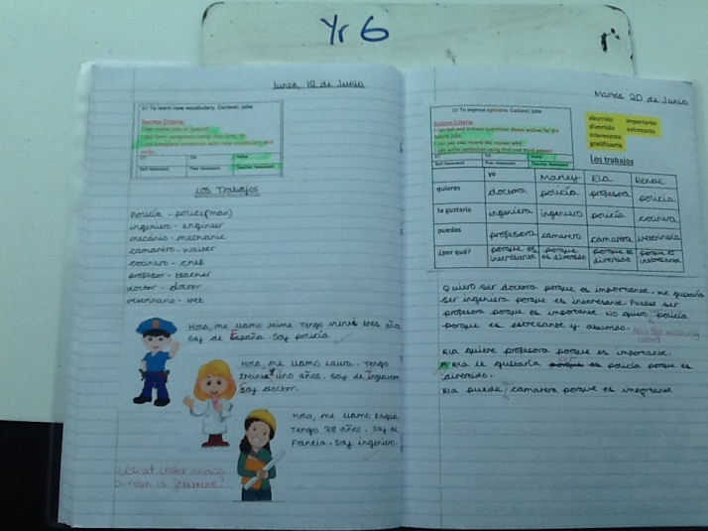
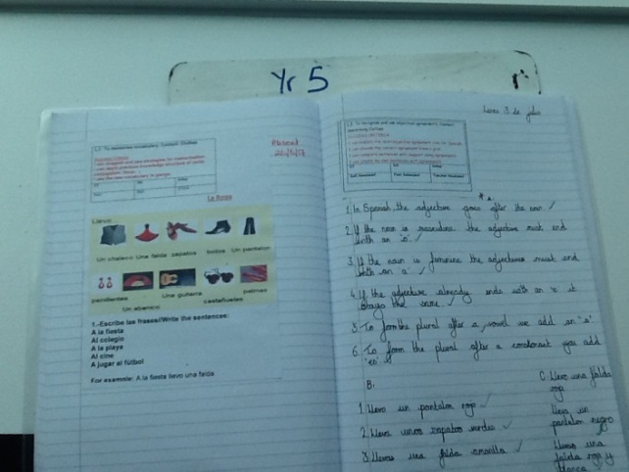
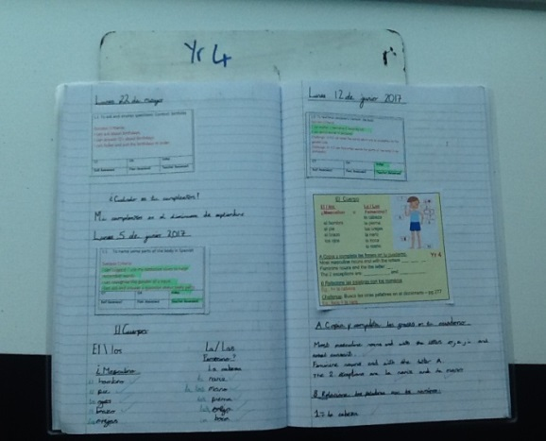
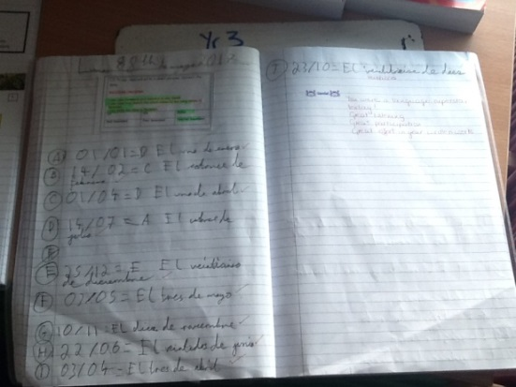
Ensuring their intellectual needs are being met and there is progression.
Yr6
Yr5
Yr4
Yr3
Notes:
Progression through KS2 – challenge of providing the right balance when more than one year group is at the same stage in their language learning.

Slide 7


¡Vamos a hablar en español!

Slide 8

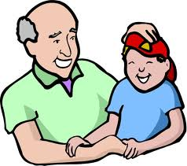

La Familia

Slide 9
La Familia
Padre padre
Padre padre
Dónde estás
Aqui, estoy aqui estoy
¿Cómo estas?
Vamos a cantar.
https://www.youtube.com/watch?v=ZCyMSBiuOTk
See video for tune

Slide 10


La Familia
Vamos a jugar!
¿Qué falta?

Slide 11




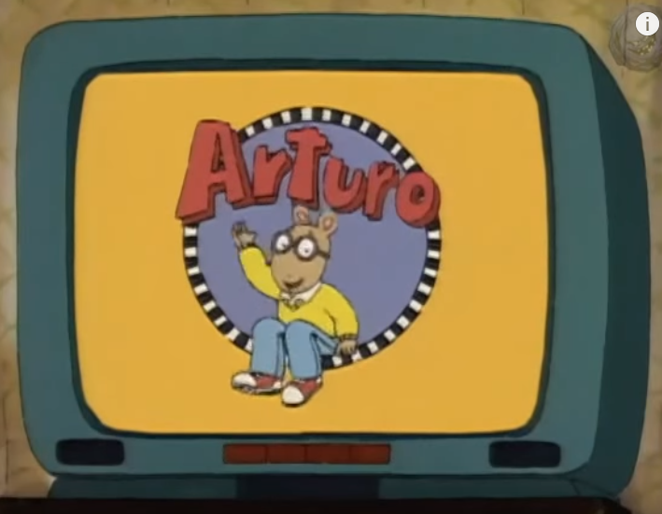
Learning with your child - Language practice.
Ask what your child has been learning at school – see newsletter on website.
Let your child teach you.
Find opportunities to use Spanish at home or when you are out.
Find simple apps so they are exposed to Spanish. They do not need to understand everthing!
Begin to learn Spanish yourself! Download an app and immerse yourself in language learning.
Apps
Duolingo
Mini lesons
Internet
www.rockalingua.com
www.calicospanish.com
http://www.spanish-games.net/
songs
cartoons
Notes:
Reinforcing language.

Slide 12




Try it for yourself!
Apps
Duolingo
Internet
www.rockalingua.com
www.calicospanish.com
http://www.spanish-games.net/
Notes:
Reinforcing language.

Slide 13
https://www.youtube.com/watch?v=8yuiUvi568I
Lots of vocab Spanaish / English
https://www.youtube.com/watch?v=DsRKoZGaoEM
Colour song – KS2. naranja vs anaranjada
https://www.youtube.com/watch?v=a_1D8Ihig-s&list=PLwsvVa1OlH1k9jS6Szvr0PgI0C6k2MUSH
Arthur cartoon
https://www.youtube.com/watch?v=JXgWG6u3nD0
Alphabet, shapes, numbers, colours, months
https://www.youtube.com/watch?v=bPRyy4DPcJg
Day, months, seasons
https://www.youtube.com/watch?v=SCKOl5Dluiw
Variety of songs
https://www.youtube.com/watch?v=kXrW39Pci1s
Very simple phrases for beginners
https://www.youtube.com/watch?v=fBnSXVBNHsg
School equipment
https://www.spanish-games.net/
Lots of different topics for Key Stage 1 and Key Stage 2

