Slide 1
Science
Parent Workshop
Autumn 2018

Slide 2
Science at Home
See science in everyday life.
Children need to know that science isn't just a subject, but a way of understanding the world around us.
How does dish washing liquid work?
How do bubbles hold their shape?
How do plants drink water?
How many drops fit on a penny?
Using a penny and a water dropper, ask your child to guess how many drops of water will fit on top of it.
Ask your child to count the drops as he or she drops them on the penny. Why doesn't the water spill off after a few drops?
Water molecules across the surface are attracted to each other. The attraction is strong enough to allow the water to rise above the penny without spilling.
At some point, the molecules of water can no longer hold together and spill off the penny.

Slide 3
Discuss science-related topics
Talk about news stories that are science based, like space shuttle missions, severe weather conditions, or new medical breakthroughs. Over time, children will develop a better understanding of how science affects our lives.
Movies and TV shows with science-related storylines are also great topics for discussion. For example: After watching Jurassic Park, you might want to discuss with your children the significance of the name of the movie or how human involvement in natural processes can cause drastic consequences.
Family science trips
Visit science museums, zoos and aquariums – they often have interactive exhibits or workshops that families can get involved in.

Slide 4
Encourage girls and boys equally
Some adults might be inclined to fix a problem for a daughter without challenging her to find the solution on her own. Many girls are left out of challenging activities simply because of their gender. Be aware that both girls and boys need to be encouraged and exposed to a variety of subjects from a very early age.
Do science together.
Children learn better by investigating and experimenting. Simple investigations done together in the home can bolster what your child is learning in the classroom.
Check with your child's teacher on what your child is currently learning in class and what activities you can explore at home. There are also many books and websites that will help.

Slide 5
How to make it science
Questions: What would happen if …?
Change 1 variable (ingredient, temperature, amount etc.
Prediction: What might happen
Hypothesis: Why it might happen
Data: What will you observe/measure to judge the result?
Vocabulary: Specific/technical words

Slide 6
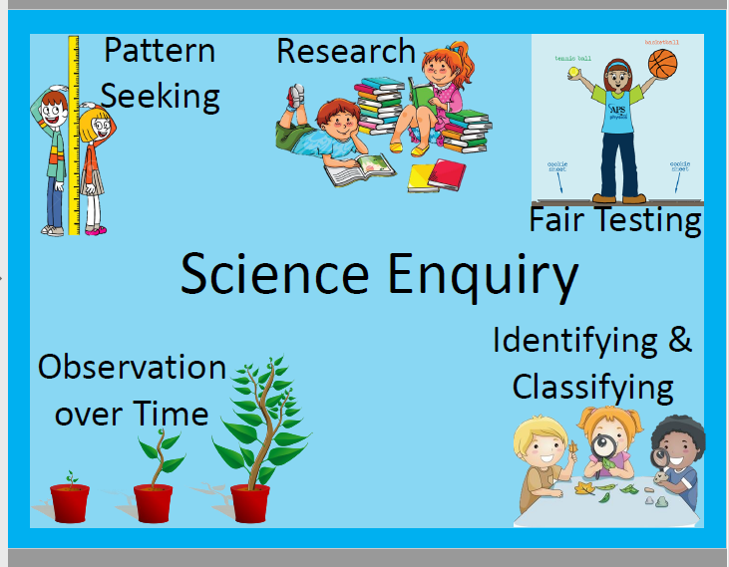
The 5 types of enquiry

