Slide 1
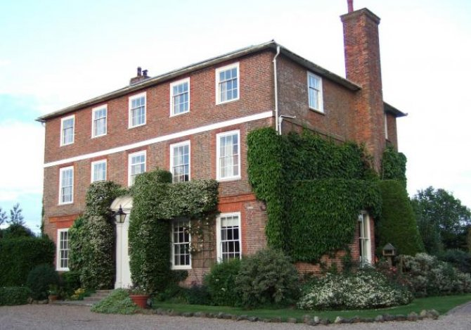
Year 5 Residential to Kench Hill Parent Information Presentation

Slide 2
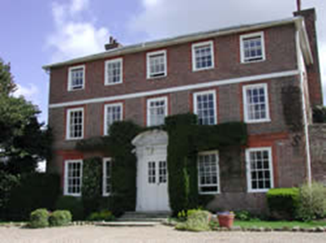
Kench Hill Centre
Established over 25 years ago, a study centre located in the heart of the Kent country side
Maintained by Hackney Education
A grand 18th century country house with 3 acres of land
Local countryside aptly named ‘The Garden of England’
Close to the coast
School has sole use of the house and grounds
Centrally heated bedrooms set over two floors (boys and girls seperated)
Toilets and showers on each floor
Mini-bus for safe transportation
Locally grown food and Halal meat
A study room which is used for prayer time

Slide 3
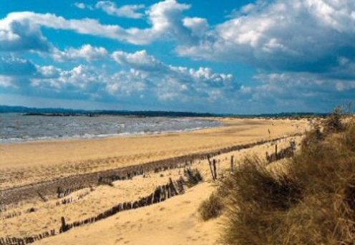
Activities
National curriculum linked activities
Classroom on site with ICT facilities and library
Pond dipping and mini-beast study
Sports available
Animals to see at Rare Breeds Centre
Outside seating areas for outside learning
Trips to local attractions
The beach a stone’s throw away
Growing and picking veg

Slide 4
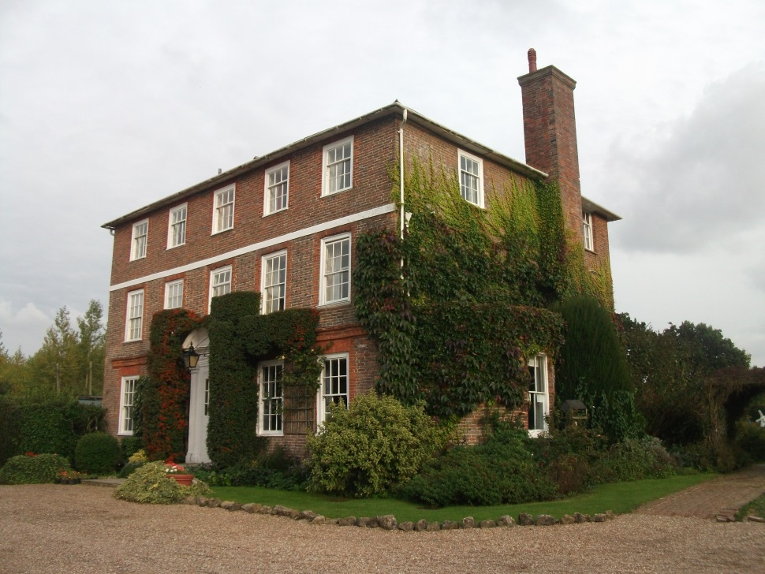
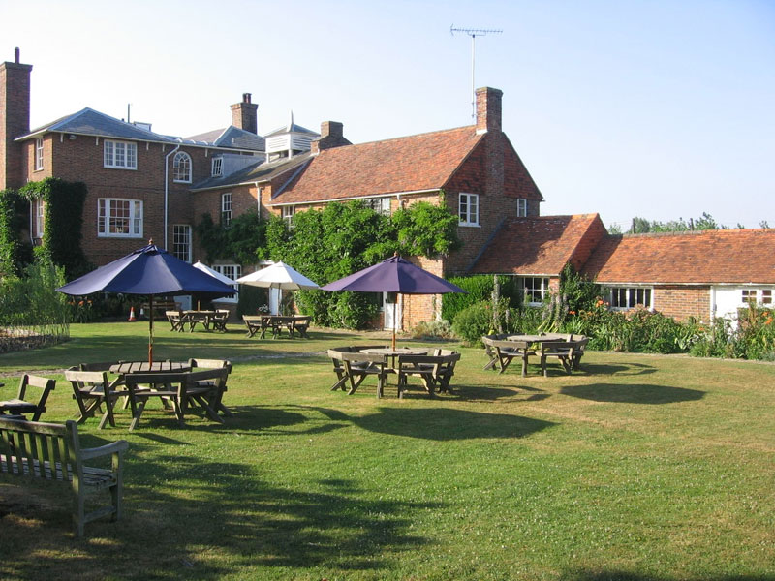
Find out more…
Kench Hill Study Centre
Apledore Rd, Tenterden, Kent TN30 7DG
www.kenchhill.co.uk

Slide 5
Costing
The price including all transport is £110. Children that recieve free school meals are then elgible for a further discount of £50, bringing the total to £60.
You can pay in full or in three instalments:
Non free-school means £110 (£30, £40 and £40)
Free-school meals £60 (£20, £20 and £20)

Slide 6
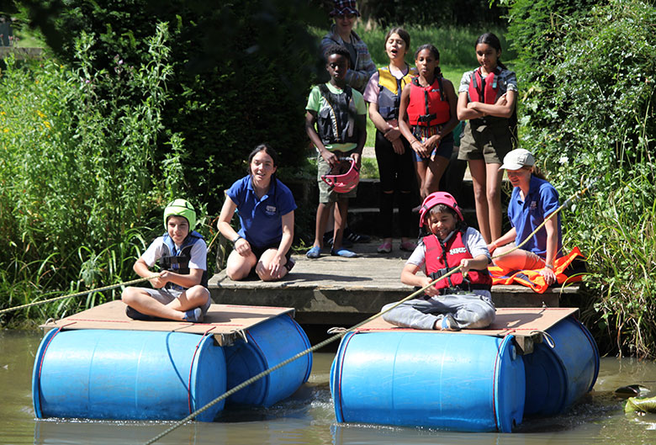
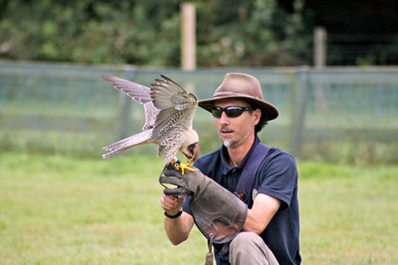
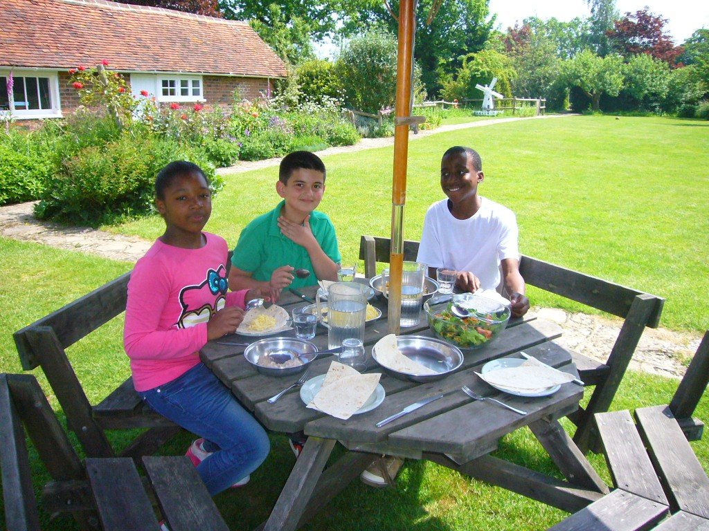
Questions?
Please return slips as soon as possible. Spaces for Kench Hill fill up fast, so don’t miss out! The deadline for first payments to be given to the school office is Friday 17th December 2021.

